Slide 1
Words of Unity: lesson resource
This lesson resource has been designed to stimulate reading, writing and speaking and listening activities in Key Stage 3 English, with some cross-curricular links to aspects of a wider citizenship agenda.
The resource prompts students to explore and reflect on their own personal values and growth, and to develop empathy by relating their own personal needs and values to those of others as they explore and reflect upon global themes.
The practical outcome will be a presentation involving written and oral skills showing evidence of individual creativity and collaborative productivity.
This resource has been created in partnership by Global Acts of Unity and the National Association for Teaching English.

Slide 2
Background
In 2014, Daesh kidnapped David Haines, a humanitarian aid worker who was helping Syrian refugees. David was held captive for 18 months before he was publicly executed by these terrorists for the world to see. Daesh used footage of his murder to try and sow division and fear.
Following this, Mike Haines OBE created Global Acts of Unity to honour his brother and defy the terrorist’s aims. He has spoken to over 90,000 people to date, including hundreds of schools, about how we can harness the power of unity to stand together with people of all faiths and none to defeat those who seek to divide us.
He has been inspired by many young people on his journey but wants to hear from many more. That’s why we have created the Words of Unity poetry competition to invite your students, as the leaders of tomorrow, to add their powerful and unique voices to this call for unity, acceptance, and understanding.
Mike wants to hear from your students about what unity means to them. Written poetry submissions as well as spoken word performances are being accepted. The competition deadline is 28 February 2020 and the winner will receive £100 of vouchers and £500 worth of supplies for their school!
This Key Stage 3 lesson resource has been created to help inspire your students to explore what unity means to them and to give them the tools to create a poem (or spoken word performance/rap etc) to enter the Words of Unity poetry competition.

Slide 3
Learning outcomes: skills development
Reading
Understanding literary and non-literary communication and forms and conventions
Exploring the implications and applications of what they have read
Responding to reading by interrogating texts and others’ responses to them
Writing
Developing ideas through purposeful sentence and paragraph structure
Crafting vocabulary and register for audience and purpose
Creative use of narrative, descriptive or persuasive strategies

Slide 4
Learning outcomes: skills development
Collaborating
Sustaining focus on purpose and outcome of task
Initiating and adapting
Encouraging and sustaining others’ contributions
Speaking & listening
Describing, predicting, reflecting
Building on others responses and ideas
Agreeing or disagreeing with others
Performance
Script learned by heart
Vocal clarity, variety & emphasis
Audio-visual aids & props
Engagement of audience & response to questions
Teamwork (where relevant)

Slide 6
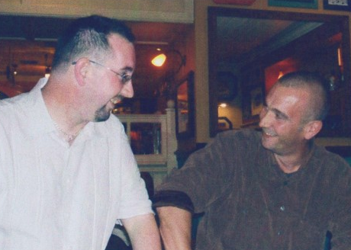
Mike and David…
Mike and David…
Mike and David were brothers and best friends growing up. When they left school they both joined the RAF and continued their close friendship as adults.
After his time in the forces David, the younger brother, became an humanitarian aid worker. He went to many far-flung countries, helping his fellow man no matter his race, religion or politics. His only objective was to help those in need.
In 2013, David went to Syria to help refugees in the conflict there.

Slide 7
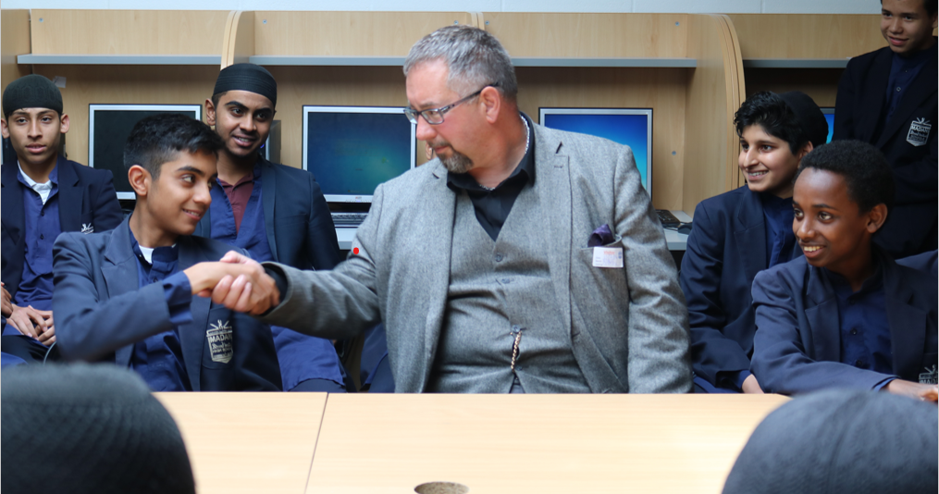
Global Acts of Unity
In Syria, David was captured by Isis terrorists and after being held prisoner for 18 months he was publicly executed.
The terrorists shared a video of the execution across the world, to try to sow hate and fear.
In response, Mike chose to focus his energy upon helping people to build a sense of unity, understanding and acceptance.
He feels this is more important than ever today. He’s learnt the most from speaking to thousands of students like you about these issues.

Slide 8
<iframe width="999" height="562" src="https://www.youtube.com/embed/Y0UpdtLCYYM" frameborder="0" allow="accelerometer; autoplay; encrypted-media; gyroscope; picture-in-picture" allowfullscreen></iframe>

Slide 9
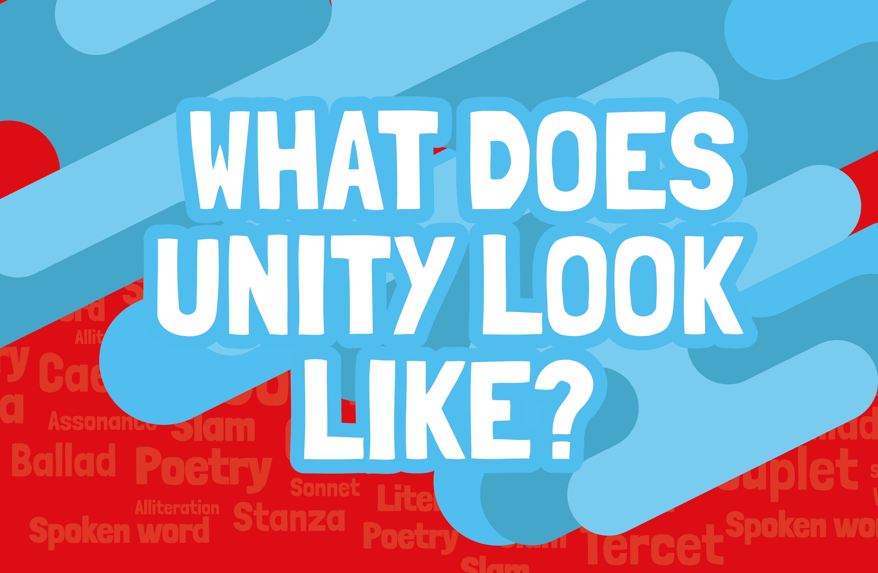
What does
Unity
look like?

Slide 10
Unity and disunity: put these words into two groups
Similarity Togetherness Brother/sisterhood Co-existence
Community One-ness Splitting Friendship Division
Co-operation Conflict Association Bonding Difference
Apartness Discord Separation Dislike Distance
Fusion Harmony Neighbourliness Hostility Alienation
Isolation Friction Love

Slide 11
Unity
Disunity
Association
Bonding
Brother/sisterhood
Co-existence
Community
Co-operation
Friendship
Fusion
Harmony
Love
Neighbourliness
One-ness
Similarity
Togetherness
Alienation
Apartness
Conflict
Difference
Dislike
Division
Discord
Distance
Friction
Hostility
Isolation
Separation
Splitting

Slide 12
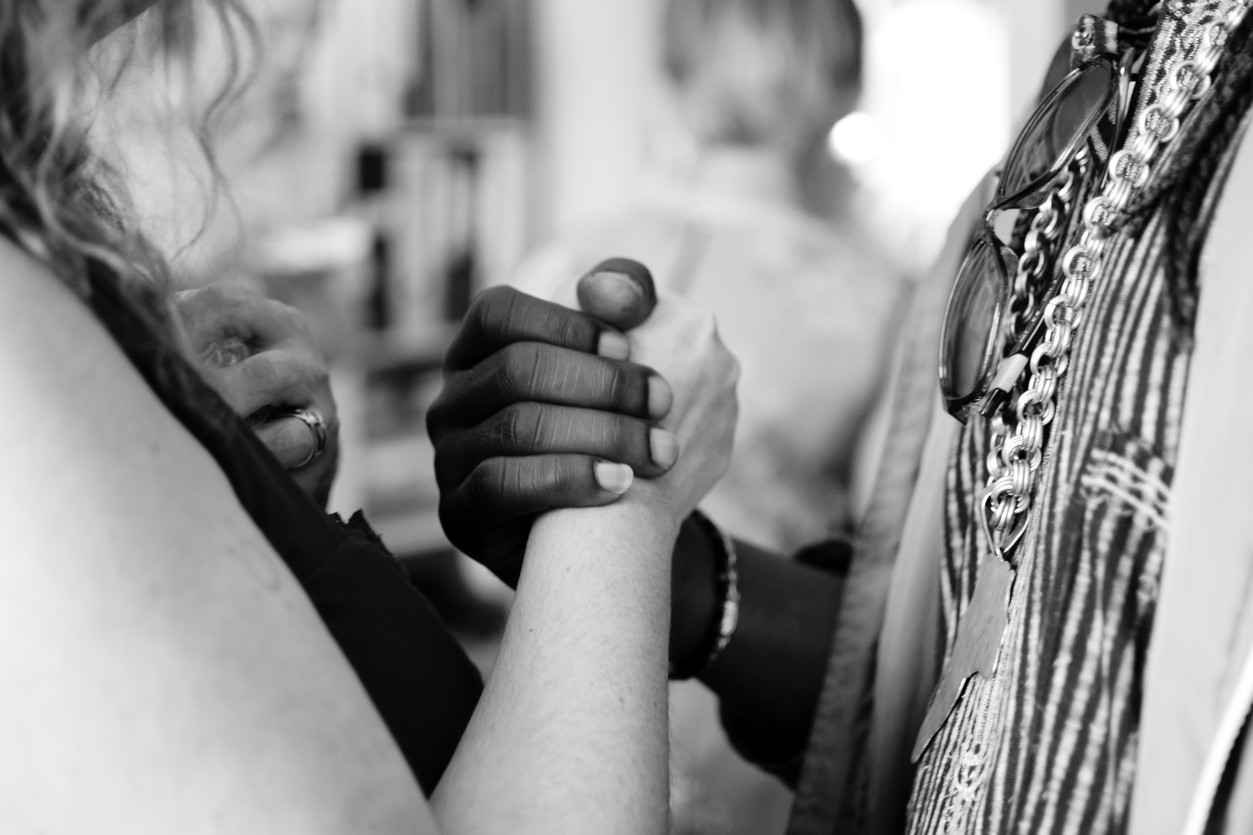
What does unity mean to you?
What does unity mean to you?
What sort of things can cause disunity between parents/guardians and children?
Where sort of things can cause disunity among friends?
What sort of things can cause disunity in school?
What sort of things can cause disunity between countries?
What was the most recent/most important thing that made you feel disunited with others?

Slide 13
Unity: put these into the order of importance to you
Culture
Ethnicity
Friends
Family
Gender identity
Hobbies
Humanity
Nationality
Language
Neighbours

Slide 14
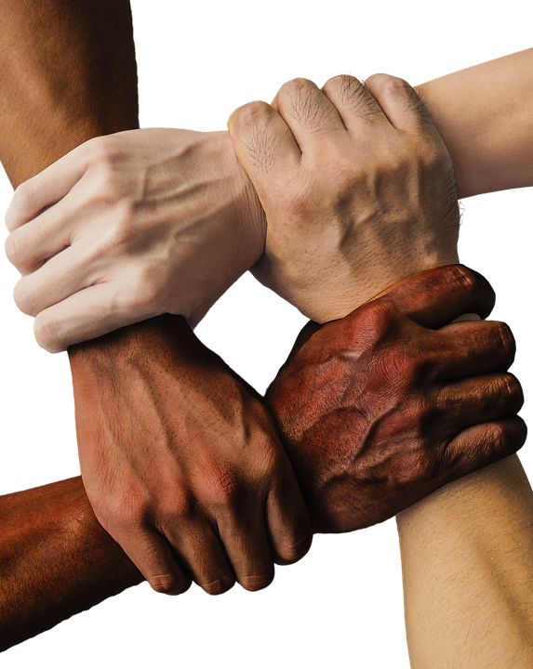
Unity: people feeling together by sharing
Beliefs – (faiths, assumptions)
Customs – (rituals, ceremonies, traditions)
Geography – (region, country
History – (past events, shared background)
Language – (vocabulary, dialect, accent)
Values – (principles, ethics)

Slide 15
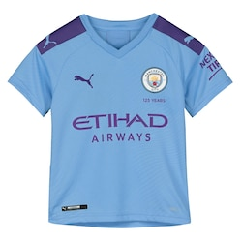
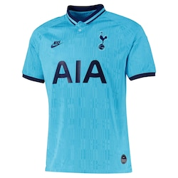
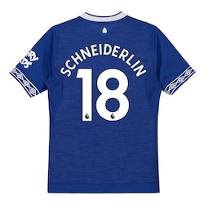
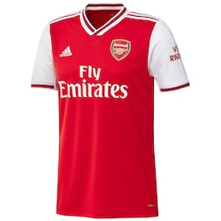
Exploring Unity
Football: do you support one team rather than the other where there is a choice?
Manchester City
Manchester United
Everton
Liverpool
Spurs
Arsenal

Slide 16
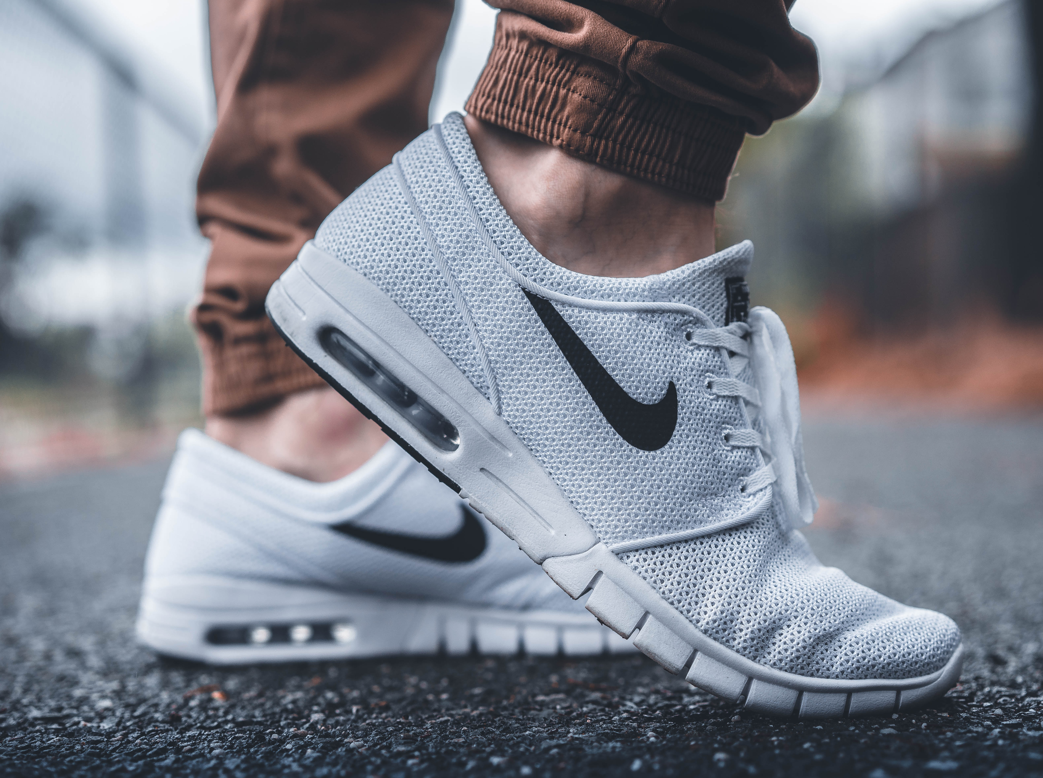
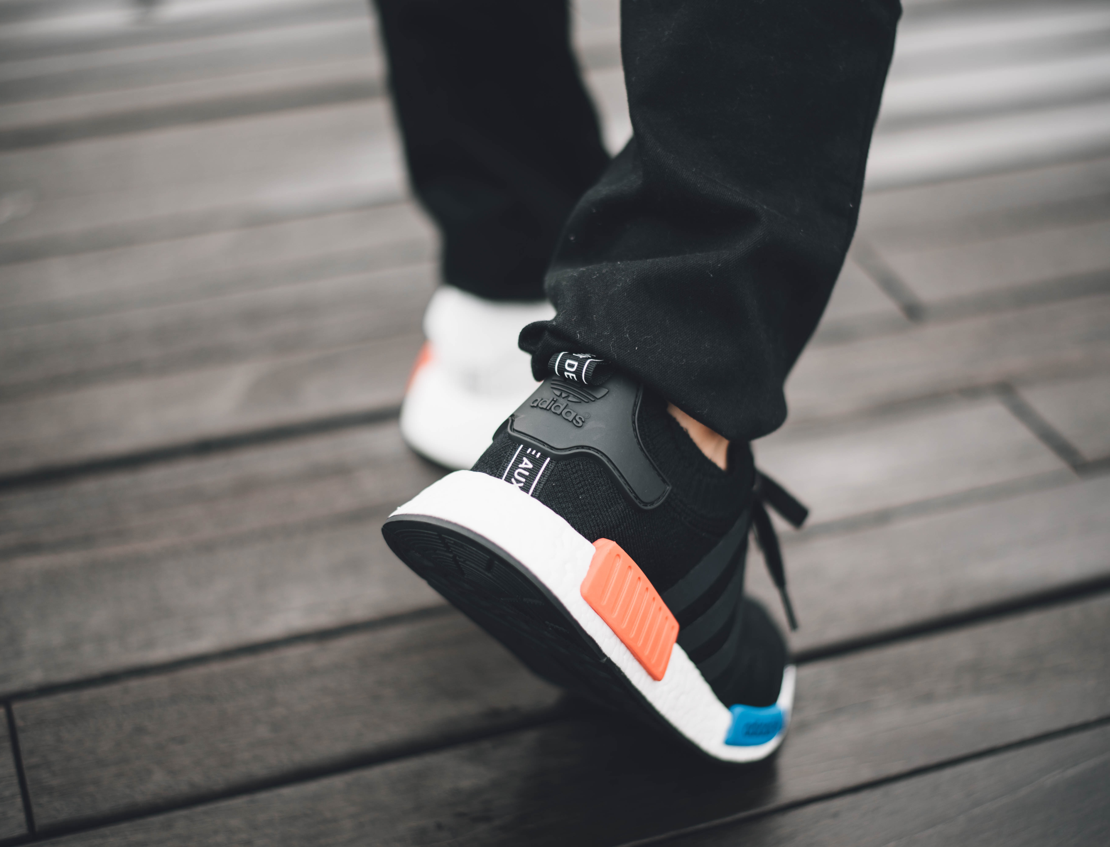
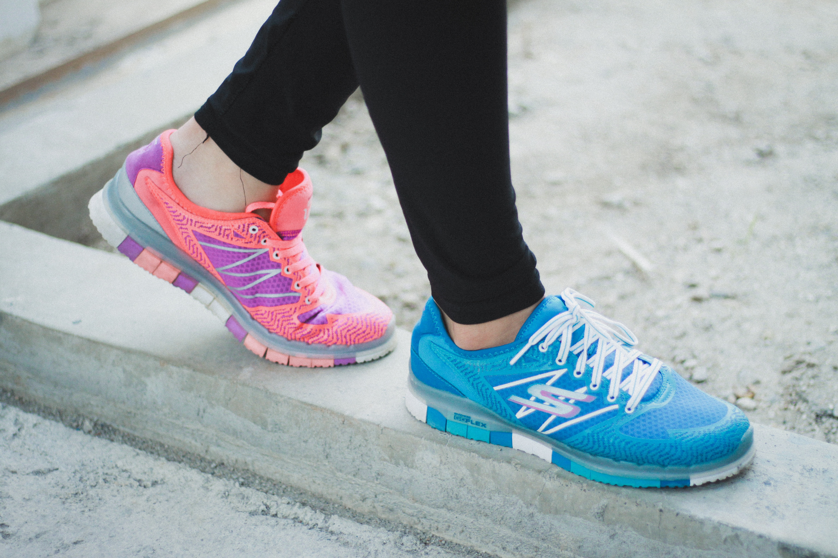
Exploring Unity
Clothes: do you choose to wear/not wear a particular brand?
What sort of people wear one of the brands you don’t wear?

Slide 17
Exploring unity

Slide 18
Exploring causes of disunity
Choose two of these and write a sentence about each, explaining how they can cause or have caused disunity:
Anger
Contempt
Hatred
Hurt
Mistrust
Prejudice
Ridicule
Superiority

Slide 19
What do we need to create unity?
Choose two of these and write a sentence for each one, explaining how they can result in or have resulted in unity:
Collaboration
Communication
Empathy
Patience
Respect
Sympathy
Tolerance
Understanding

Slide 21
What is Words of Unity?
Mike Haines wants you to join his journey to help spread a message of unity, tolerance, and understanding among our young people.
Words of Unity is a national poetry competition. To enter you need to create a poem, of any kind, that expresses how YOU feel about unity.
The winner will receive £100 of vouchers and £500 of supplies for their school community.

Slide 22
Unity and you
Read
Talk
Write
Collaborate
Perform

Slide 23
Warming up to write
Invent a recipe for a sense of unity, with ingredients and amounts, e.g.
a pinch of ….
a spoonful of ….
a few ounces of ….
a cup of ….
add some….
stir and blend with some……….
Or…
List five things you could create or do to make people feel united
Think of four places where people feel united - e.g. a concert, match or festival.

Slide 24
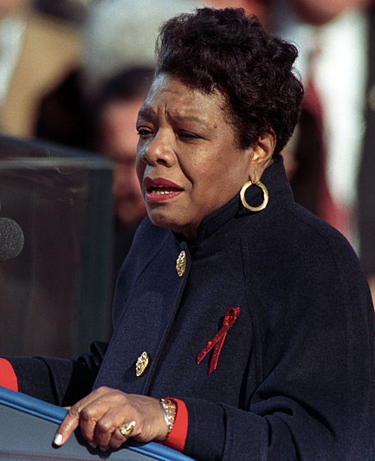
Other poems around Unity to explore….
Maya Angelou: "The Rock Cries Out to Us Today“
Each of you a bordered country,
Delicate and strangely made proud,
Yet thrusting perpetually under siege.
Your armed struggles for profit
Have left collars of waste upon
My shore, currents of debris upon my breast.
Yet, today I call you to my riverside,
If you will study war no more.
Come, clad in peace and I will sing the songs
The Creator gave to me when I
And the tree and stone were one

Slide 25
Other poems around Unity to explore….
Unknown author: Builder or Wrecker?
I watched them tear a building down;
A gang of men in a busy town.
With a mighty heave and a lusty yell,
They swung a broom and a side wall fell.
I said to the foreman, “Are those men skilled
As the men you’d hire if you had to build?” He gave me a laugh and said, “No indeed
Just a common laborer is all I need.
And I can wreck in a day or two
What it took the builder a year to do.”
And I thought to myself as I went my way,
“Just which of those roles have I tried to play?
Am I builder who works with care
Measuring life by the rule and square,
Or am I a wrecker as I walk the town
Content with the labor of tearing down?”

Slide 26
Other poems around Unity to explore….
Unknown Author: Unity
I dreamt I stood in a studio, And watched two sculptors there. The clay they used was a young child’s mind, And they fashioned it with care.
One was a teacher – the tools she used Were books, music and art.
The other, a parent – working with a guiding hand
And a gentle loving heart.
Day after day the teacher toiled
With a touch that was deft and sure.
While the parent laboured by her side,
And polished and smoothed it o’er.
And when at last, their task was done,
They were proud of what they had wrought.
For the things they had moulded into the child,
Could neither be sold nor bought.
And earth agreed they would have failed
If each had worked alone.
For behind the teacher stood the school,
And behind the parent, the home.

Slide 27
Thinking about the poems…
After reading it once, which words do you remember?
After reading it again, what ideas or feelings does the poem express?
Does it remind you of anything you’ve read?
Does it remind you of anything you’ve seen or done?
What do you think the writer wanted you to feel or understand?

Slide 28
Here are some verse forms you can try:
Haiku
A Haiku is a simple short verse form of three lines. The first and third lines have five syllables. The middle line has seven syllables.
We can be mere drops 5
In the ocean’s vast deep swell: 7
Or, call us ocean. 5
There’s too much aggro 5
In our public life today: 7
Love is my bag, Bro. 5

Slide 29
Unity Haikus
United rainbow,
Dismiss discrimination,
Depicting pure heart.
Diwaker Pokhrival
Our world is filled with
Powerful stories that can
Bring us together.
Leslie Thomas
Where humanity
Sowed faith, hope and unity,
Joy’s garden blossomed.
Aberjhani

Slide 30
Try your own Haiku about unity
Try a three verse sequence in haiku form:
Too many people
Think success means beating others –
Think life’s a tough race
That means one winner,
Everyone else a loser.
Medals aren’t for all.
I think it’s better:
That we run our human race
As Team Together.

Slide 31
Here are some verse forms you can try
Rhyming couplets
A pair of successive lines of verse, typically rhyming and of the same length – e.g. Song of the Witches from Shakespeare’s Macbeth.
Double double, toil and trouble.
Fire burn and cauldron bubble.

Slide 32
Here are some verse forms you can try
Spoken word – rap or chorus
A rap is a rhythmic type of rhythmic spoken verse, using rhyme or half rhyme. It usually uses street slang. For example:
Listen, everyone, to me
When I tell you I can see
You ain’t as good as me
You can try but you will never be.
‘Cos no amount of imitation,
No amount of education -
No-one in this whole great nation
Can match my rapping dedication.
A choral poem is one where a group of speakers divide up the lines of a poem for individual, pair, triple or whole-group delivery.

Slide 33
Here are some verse forms you can try
Cinquain
The format of a cinquain is five lines, and each line of the poem contains the following number of syllables: 2, 4, 6, 8, 2. You can use rhyme and it works best if the last line is a two syllable sentence. For example:
You pinch
My stuff, my tops,
Shampoo, my iPhone X
So, Sis, if friends you want to be –
Stop it!

Slide 34
Here are some verse techniques you can try
Metaphor
Assonance
A metaphor is a way of describing someone or something as if they are, literally, something else. For example: “You are my sunshine” or “The boat moved slowly on the mirror of the lake”.
Repetition of vowel sounds in nearby syllables e.g. Try to light the fire
Simile
Alliteration
A simile is a way of describing someone or something by direct comparison, using the words “like” or “as”. For example: “You are like a ray of sunshine to me. Or The lake was as still as a mirror”.
Repetition of consonant sounds at the beginning words e.g. Peter Piper picked a peck of pickled peppers

Slide 35
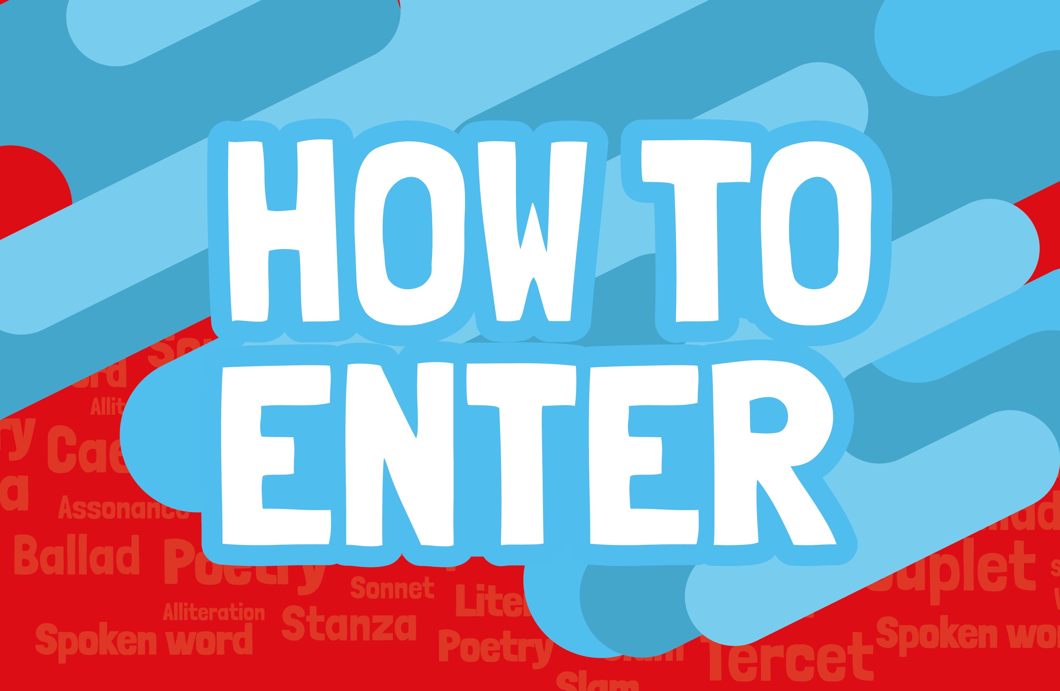

Slide 36
How to enter
Send your poem with your name, age, school and location to:
WordsofUnity@fourcommunications.com
Or you can post it to:
Words of Unity
Four Communications
20 St Thomas Street
London SE1 9BF
Enter by 28 February 2020 for your chance to win £100 of vouchers and £500 of supplies for your school community.

